Slide 1
Intro to Programming
2022 Erik Kesa

Slide 2
What Will you be learning this semester?
Programming as the art of communication between person and machine.
Programming as a team-based effort of building something great.
The programmer’s mindset to solving a problem.
Programming from the machine’s perspective.
The basics of C - the mother of all most programming languages.
Fundamental concepts of computer science, software development and game programming.

Slide 3
How will the course be structured?
Each 4 lesson meeting will be divided into a theoretical part (2 lessons) and a practical part (2 lessons) to provide time for presentation of homeworks and solve HackerRank challenges.

Slide 4
Meetings And Topics
- 10. Oct 2022 14:00 [4h] – Course overview, Intro to C, compilation and Hello World
- 11. Oct 2022 14:00 [4h] –- Variables and statements ,
- 18. Oct 2022 14:00 [4h] – Data Types
- 25. Oct 2022 10:00 [4h] – Loops and Functions
- 01. Nov 2022 10:00 [4h] – First homework Deadline
- 08. Nov 2022 10:00 [4h] –Pointers and Arrays

Slide 5
Meetings And Topics
- 15. Nov 2022 10:00 [4h] – Structures and Strings, Working with strings
- 22. Nov 2022 10:00 [4h] – Data structures [Linked List], File I/O
- 29. Nov 2022 10:00 [4h] - Second Homework Deadline, Linked list [P]
- 06. Dec 2022 10:00 [4h] – Overview of Object Oriented programming, C++
- 12. Dec 2022 10:00 [4h] –- Command Pattern
- 13. Dec 2022 10:00 [4h] – Player AI for Tic-Tac-Toe using Minimax
- 20. Dec 2022 10:00 [4h] – Final project presentation [P]

Slide 6
Grading
HackerRank - Total challenges 11 easy and 9 medium – Each easy gives one point, and medium 2 points. (As a minimum, 10 challenges must be solved). Hackerrank challenges will be solved during practice lessons, at an individual pace, with consultation available.
Homeworks - 2 homeworks total, each giving 15 points.
Final project – will count for 50 points.

Slide 7
Results
91-100p = “5”
81 -90 = ‘4”
71-80 = “3”
61-70 = ”2”
51 – 60 = “1”

Slide 8
First homework - 1. Nov 2022
The aim of this homework will be to create a basic calculator. The criteria will be: a) The calculator enables addition, subtraction, multiplication and division b) The calculator has an understandable user interface c) The calculator handles invalid input by the user by returning an error message where appropriate d) The results produced are correct. e) The calculator does not crash

Slide 9
Second Homework - 29. Nov 2022
The aim of this homework will be to create a game database application. a) The game database will be an application to store info about games that a person owns b) It should support adding new games and removing existing ones. c) It should be queryable by an identifier, Game title and Publisher d) All information should be stored in a file.

Slide 10
Final Assignment
The Aim of the assignment will be to create a text-based RPG game using C. The result should be a terminal based application Game Requirements:
Combat mechanic - The game should have a player character who will battle monsters and explore dungeons. The combat mechanic should contain some randomness.
Player - The player should have at least 3 statistics: Life, Attack Strength, Defense Strength
Monsters – The monsters should have at least 3 statistics: Life, Attack Strength, Defense Strength
Implemented player choice – The story should present at least 3 player choice moments.
User Interface – Command line.
File persistence
Story
The Game has to work!

Slide 11
Rules
Any and All code you write – you must be able to explain!
I dislike the sound of my voice being combined with that of yours, so let’s take turns speaking.
Failure to meet a deadline will result in 5 points subtracted from the final result.

Slide 12
Useful resources
Https://www.hackerrank.com - practice environment, will be used in practice lessons
https://www.tutorialspoint.com/cprogramming/ - covers basic topics, that we will be going over during lessons.
https://www.gnu.org/software/gnu-c-manual/gnu-c-manual.html – the C language reference.
https://www.tutorialspoint.com/compile_c_online.php - online C compiler

Slide 13
Software we will use
https://jmeubank.github.io/tdm-gcc/ - TDM GCC - C compiler for windows, easy to use and set up
https://code.visualstudio.com/ - Visual Studio Code IDE

Slide 14
Course discord
https://discord.gg/PtSy7GBS

Slide 15
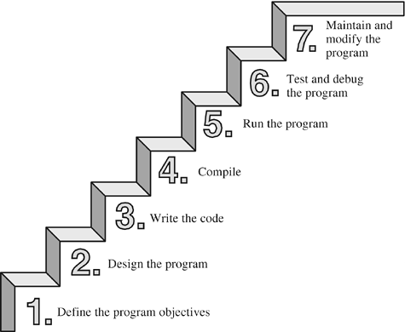
Software Development Basics
The aim of software development is to create computer programs for the users. Software developers achieve this through programming – creating the source code containing instructions for a computer to act in certain ways or manipulate data in order to achieve some result.

Slide 16
Software Development Basics
An algorithm is a set of instructions for solving a problem or accomplishing a task.
An example of an algorithm is a recipe.

Slide 17
Excersise
Split up into groups of 2 – where one person will be the programmer and one, the computer
The programmer will be given an object to draw
The programmer will instruct the computer using only basic shapes (Square, Triangle, circle, line) and basic directions (Below, Above, To The Left, To The right, in the middle)

Slide 18
TURING Machine
A concept developed by Alan Turing (1912 - 1954)
https://www.youtube.com/watch?v=dNRDvLACg5Q

Slide 19
Questions?

